Slide 1

LOAN LENDING PREDICTION
BY :- MADHU BALONI
:- DEEPAK SINGH BOHRA

Slide 2
OBJECTIVE
Lending Club connects people who need money (borrowers) with people who have money (investors). Hopefully, as an investor you would want to invest in people who showed a profile of having a high probability of paying you back

Slide 3
DATA INFORMATION
Credit policy
Purpose
Interest Rate
Installment
Log of Annual Income
Debt to Income
FICO
Days with Credit Line
Revolving Utilization Rate
Borrower Revolving Balance
Inquries of Last 6 months
Due on payment on last 2 month
Public Records

Slide 4
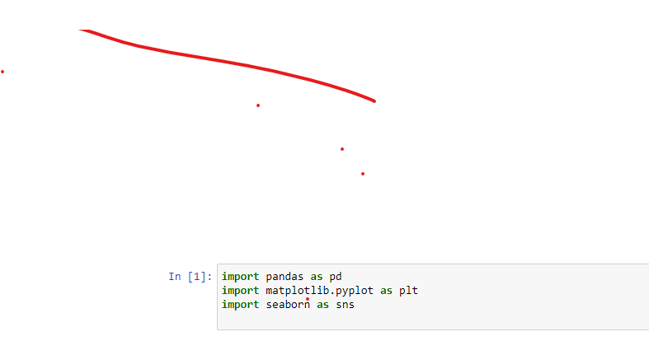
Imports the Libraries

Slide 5
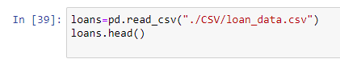
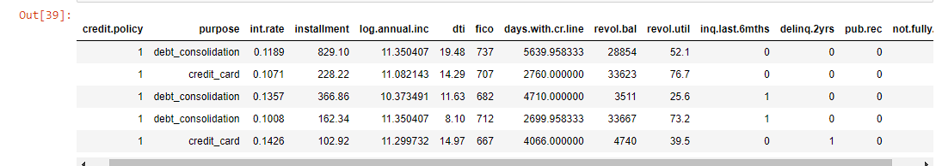
Get the Data

Slide 6
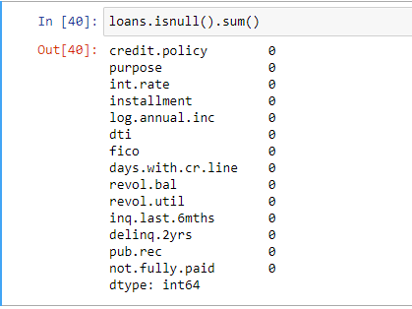
Check the Data

Slide 7
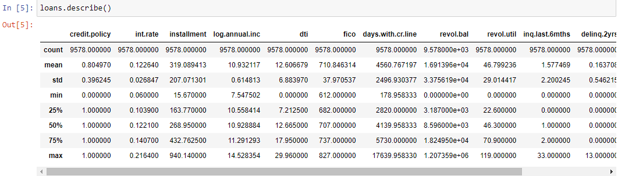
More about the data
Like Count,Mean,Standard Deviation,Min-Max values ,n% of data

Slide 8
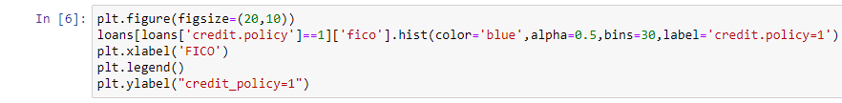
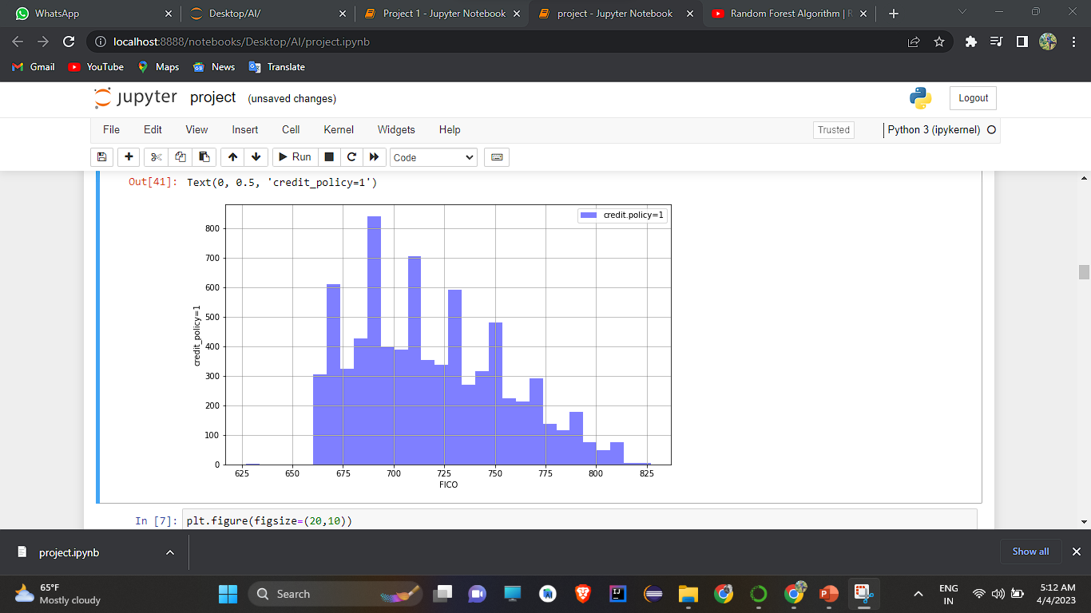
Histogram for FICO when credit=1

Slide 9
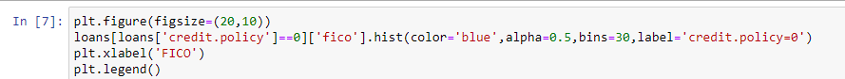
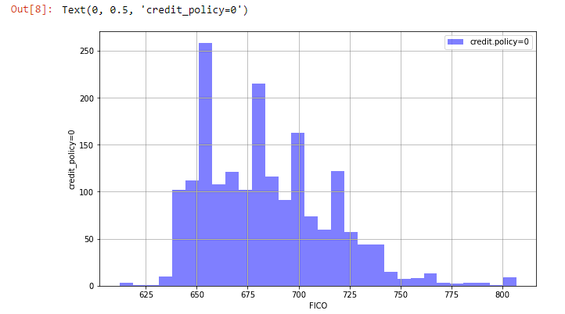
Histogram for FICO when credit=1

Slide 10
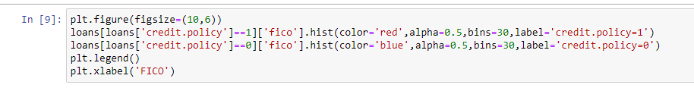
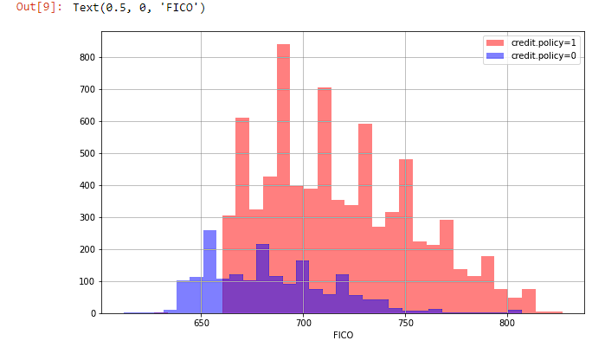
Combined Histogram with credit policy =0 and 1

Slide 11
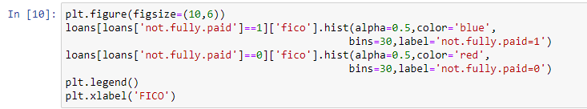
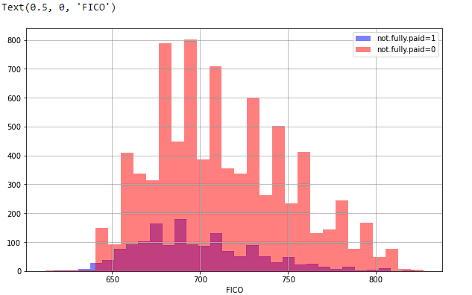
Combined Histogram with not fully paid=0 and 1

Slide 12
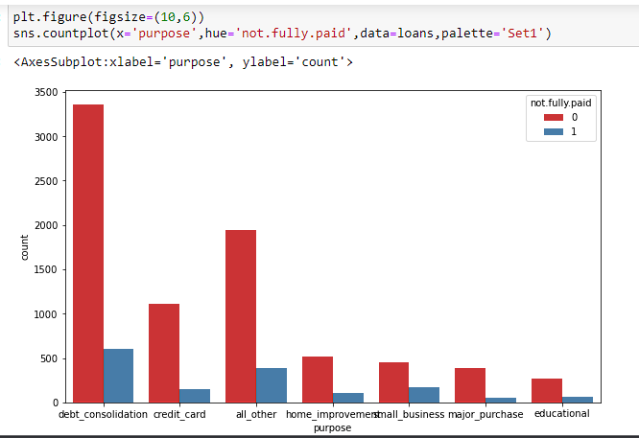
Count plot graph of purpose

Slide 13
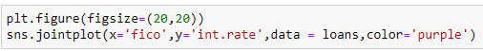
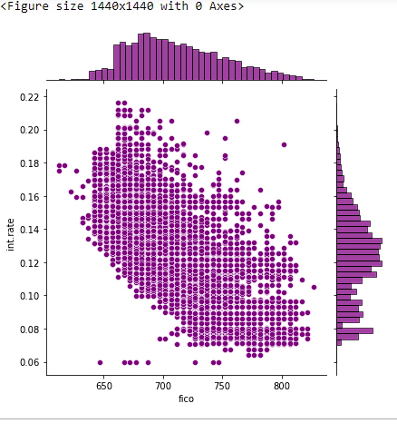
Jointplot graph of fico and intrest rate

Slide 14
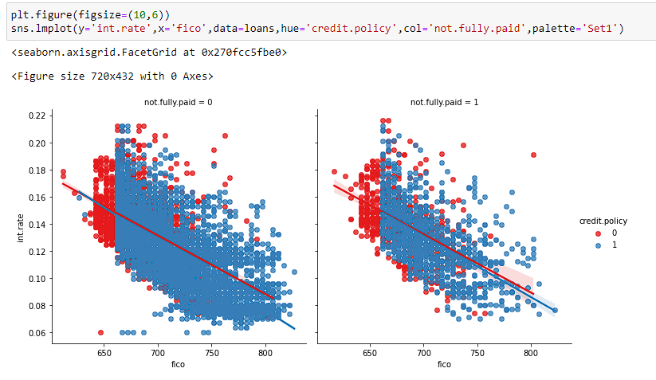
Lm plot graph of fico and Intrest rate

Slide 15
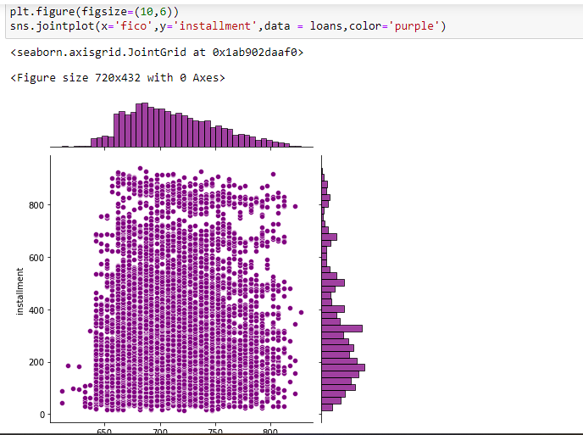
Relation between fico and installment

Slide 16
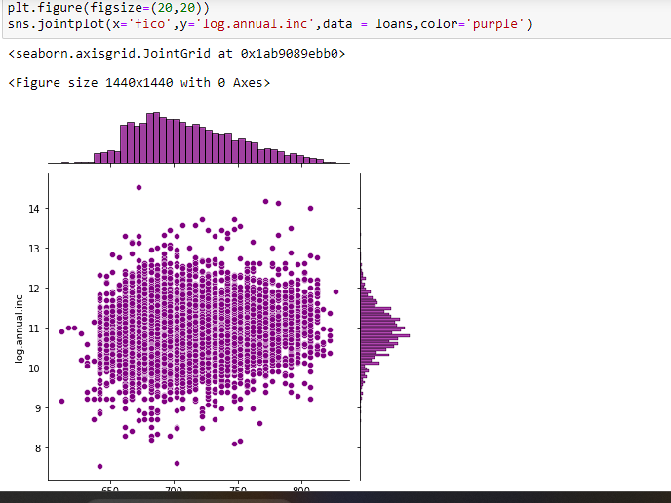
Relation between fico and annual income

Slide 17
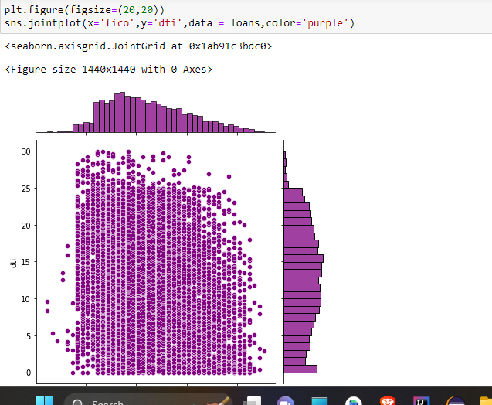
Relation between dti and fico

Slide 18
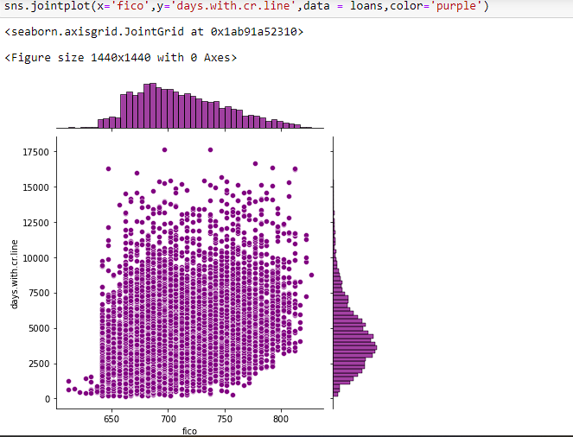
Relation between days with credit line and fico

Slide 19
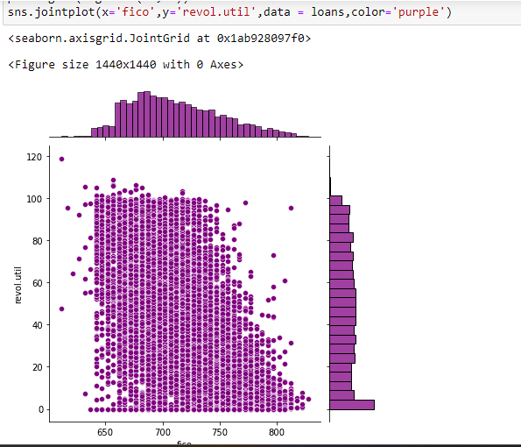
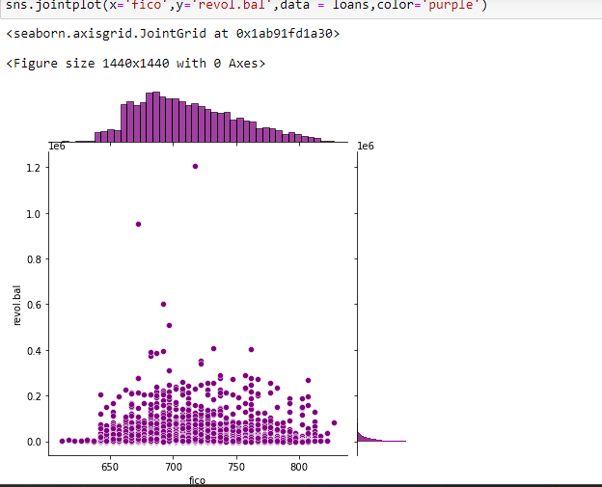
Relation between revol.util and fico

Slide 20
Relation between revol.util and fico

Slide 21
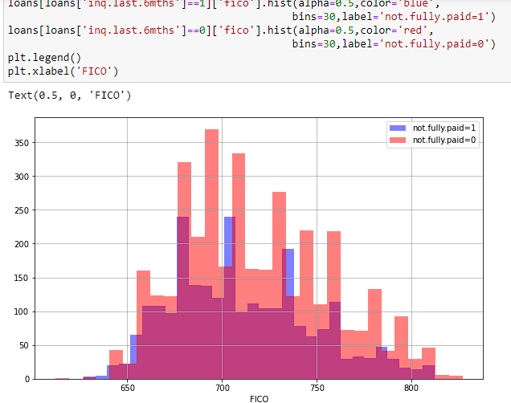
Relation between inqlast6mnts and fico

Slide 22
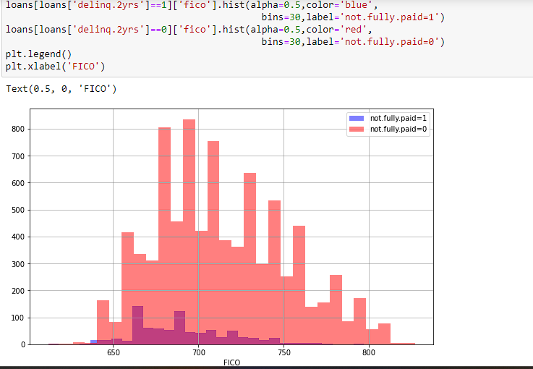
Relation delinq.2yrs and fico

Slide 23
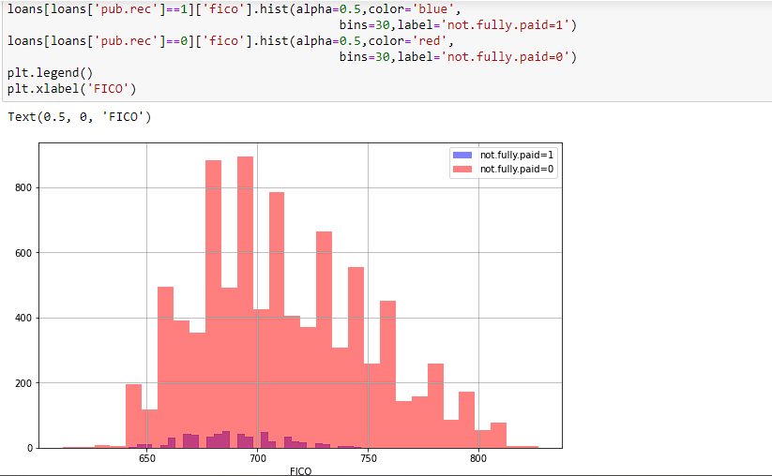
Relation between public record and fico

Slide 24
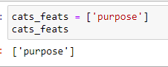
Categorical Features

Slide 25
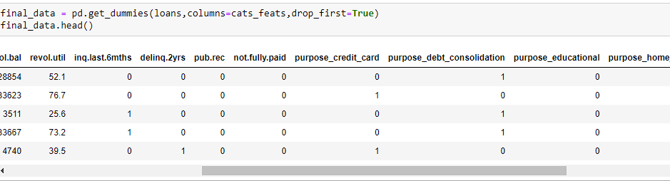
Final Data

Slide 26
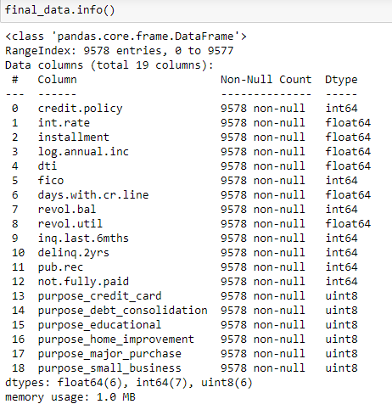
Final Data Information

Slide 27
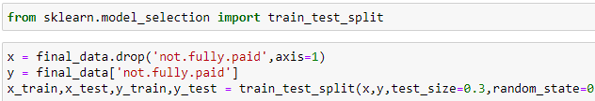
Train Test Split the final Data

Slide 28
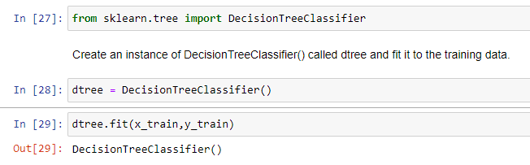
Evaluation of Decision Tree

Slide 29
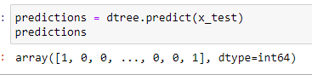
Predictions of Decision Tree

Slide 30
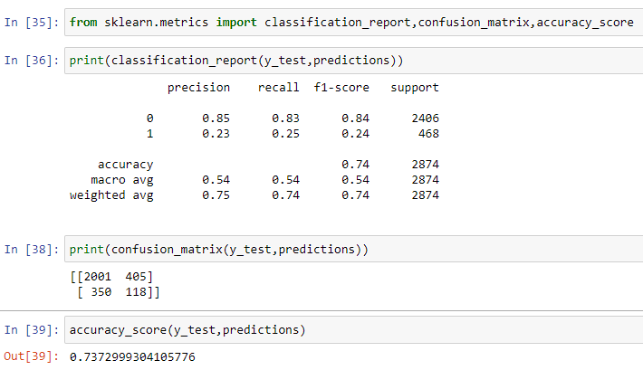
Accuracy_Score

Slide 31
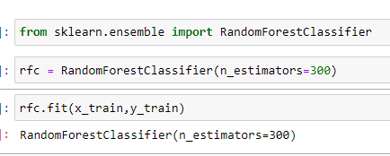
Evaluation of Random Forest Tree

Slide 32
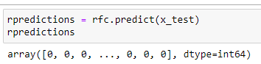
Prediction of RFC

Slide 33
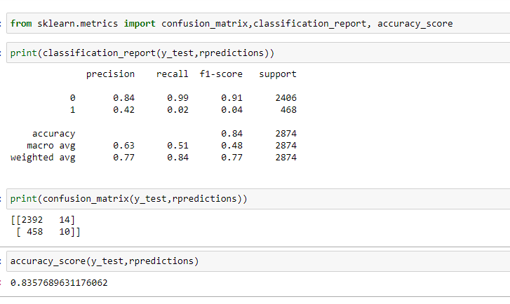
Accuracy_Score

Slide 34
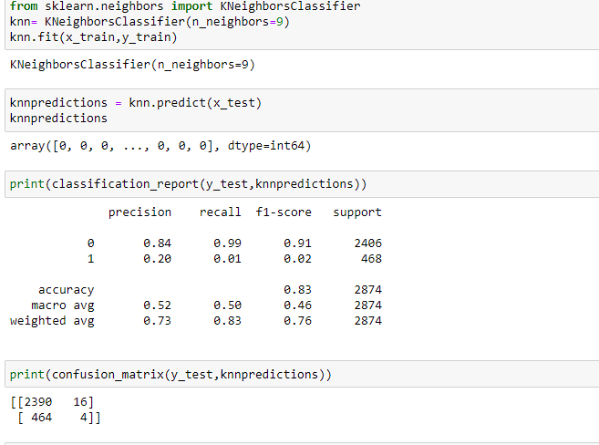
K Neighbours Classifier

Slide 35
CONCLUSION
Decision tree confusion matrix
A good model is one which has high TP and TN rates, while low FP and FN rates.
Therefore Random forest model is best for this data compared to other
Random forest confusion matrix
K nearest neighbours

Slide 36
THANK YOU
SOURCE:-www.Kaggle.com

